Slide 1




Solving constraint satisfaction problems using RAT
29 January 2022

Slide 2
The Team
Sarthak S Kumar -PES2UG21CS432
Varun C -PES2UG21CS593
Vishal M Godi -PES2UG21607
Section: K
Batch: 2

Slide 3
Constraint satisfaction problems?

Slide 4


It is the process of finding a solution to a set of constraints, that impose conditions that the variables must satisfy. A solution is therefore a set of values for the variables that satisfies all constraints.
Constraint satisfaction problems on finite domains are typically solved using a form of search. The most used techniques are variants of backtracking using recursion, constraint propagation, and local search.

Slide 5
Recursive algorithms

Slide 6

A recursive function is one that calls itself with simpler values.
In recursion, we try to solve a problem by solving a smaller instance of the same problem, unless the problem is so small that we can just solve it directly.
Backtracking is a recursive tool for solving constraint satisfaction problems

Slide 7
Backtracking

Slide 8



It's an algorithmic-technique for solving problems recursively by trying to build a solution incrementally, one at a time removing those solutions that fail to satisfy the constraints of the problem at any point of time
In short words, it's searching every possible combination in order to solve a computational problem.
In recursion, the function calls itself until it reaches a base case.
in backtracking, we use recursion to explore all the possibilities until we get the best result for the problem.

Slide 9

Implementation

Slide 10
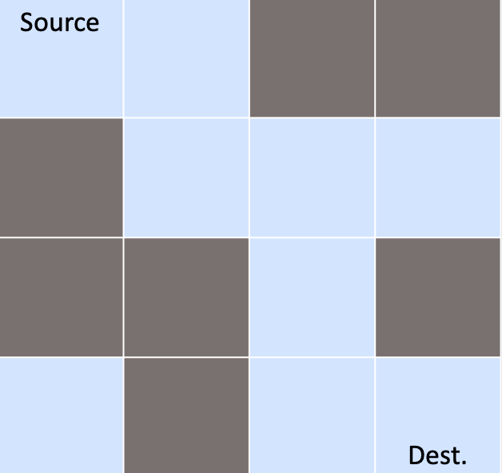
Rat in a maze

Slide 11
Rat in a maze

Slide 12
Rat in a maze

Slide 13
Rat in a maze

Slide 14
Rat in a maze

Slide 15
Rat in a maze

Slide 16
Rat in a maze

Slide 17
Rat in a maze

Slide 18
Rat in a maze

Slide 19

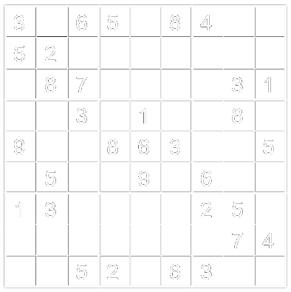
Sudoku
Constraints
Each row must have unique numbers from 1–9
Each column has unique numbers from 1–9
Each sub-grid has unique numbers from 1–9

Slide 20
Sudoku
1
The backtracking algorithm here will try to place each number in each row and column following the constraints until the puzzle is solved.

Slide 21
Sudoku
1
2
The backtracking algorithm here will try to place each number in each row and column following the constraints until the puzzle is solved.

Slide 22
Sudoku
1
2
9
7
4
1
3
7
8
6
No solution?
The backtracking algorithm here will try to place each number in each row and column following the constraints until the puzzle is solved.

Slide 23
Sudoku
1
2
9
7
4
1
3
7
8
No solution?
Backtrack
The backtracking algorithm here will try to place each number in each row and column following the constraints until the puzzle is solved.

Slide 24
Sudoku
1
2
9
7
4
1
3
7
No solution?
Backtrack
The backtracking algorithm here will try to place each number in each row and column following the constraints until the puzzle is solved.

Slide 25
Sudoku
1
2
9
7
4
1
3
9
No solution?
Backtrack
Retry
The backtracking algorithm here will try to place each number in each row and column following the constraints until the puzzle is solved.

Slide 26
Sudoku
1
7
9
2
9
1
3
4
7
6
8
4
6
2
9
5
2
6
4
5
9
7
No solution?
7
4
1
2
Backtrack
8
1
7
2
4
3
Retry
8
9
4
7
6
6
9
2
3
5
1
8
Found Solution!
7
4
8
1
9
The backtracking algorithm here will try to place each number in each row and column following the constraints until the puzzle is solved.

Slide 27



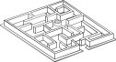
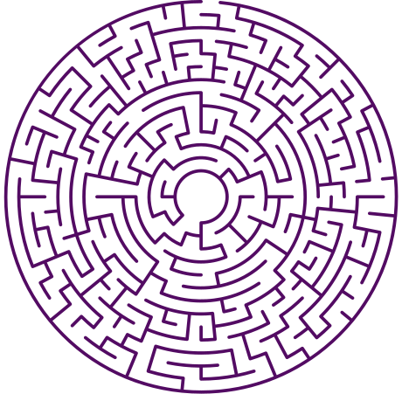
UI
Developing a basic UI to facilitate interactions with the reviewers and enable us to present the problems and their solutions in a more organized and interactive manner.
PROJECT
PROJECT
RAT
RAT

Slide 28
Technologies and Resources

Slide 29




Slide 30
Thank you!
Solving constraint satisfaction problems using RAT

